Slide 1
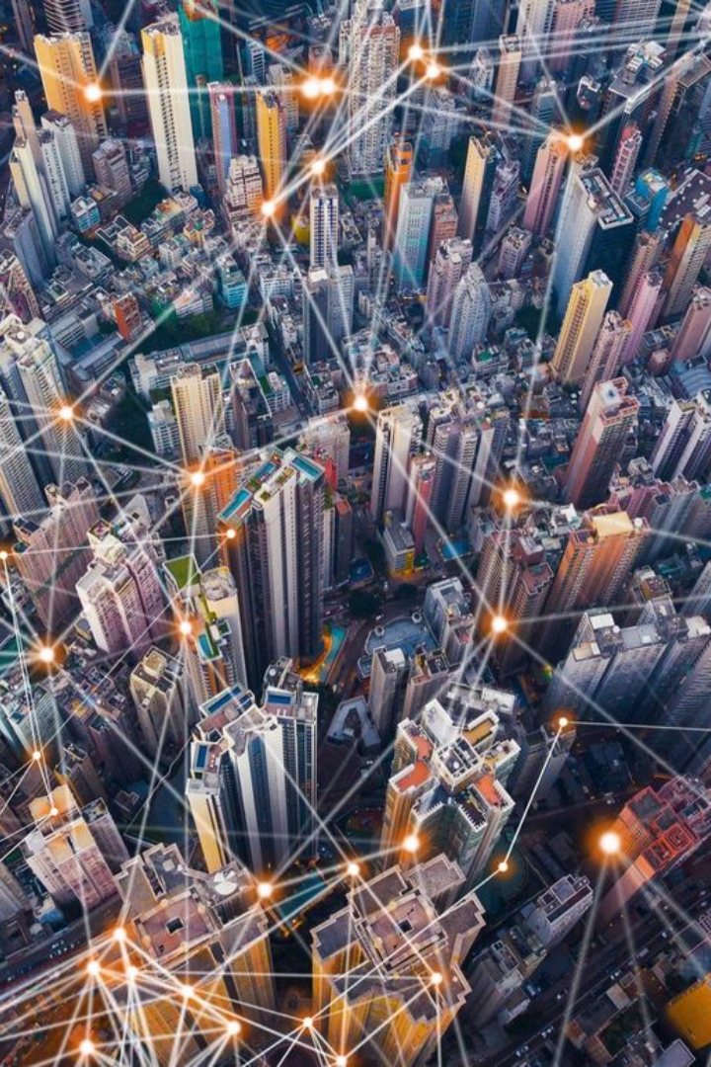

VisionNet: Enhancing Smart City Infrastructure through Advanced Object Detection
VisionNet is revolutionizing smart city infrastructure by implementing advanced object detection technologies. Through the use of cutting-edge AI and computer vision, VisionNet is optimizing urban environments for efficiency and safety.

Slide 2
Importance of Smart City Infrastructure
Efficient Resource Management
Enhanced Safety and Security
Economic Growth and Development
Smart city infrastructure enables the optimal utilization of resources, leading to sustainable development and reduced energy consumption.
Advanced infrastructure enhances public safety through real-time monitoring and proactive response mechanisms, ensuring the well-being of citizens.
Robust infrastructure fosters economic growth by attracting investments and providing a conducive environment for businesses to thrive.

Slide 3
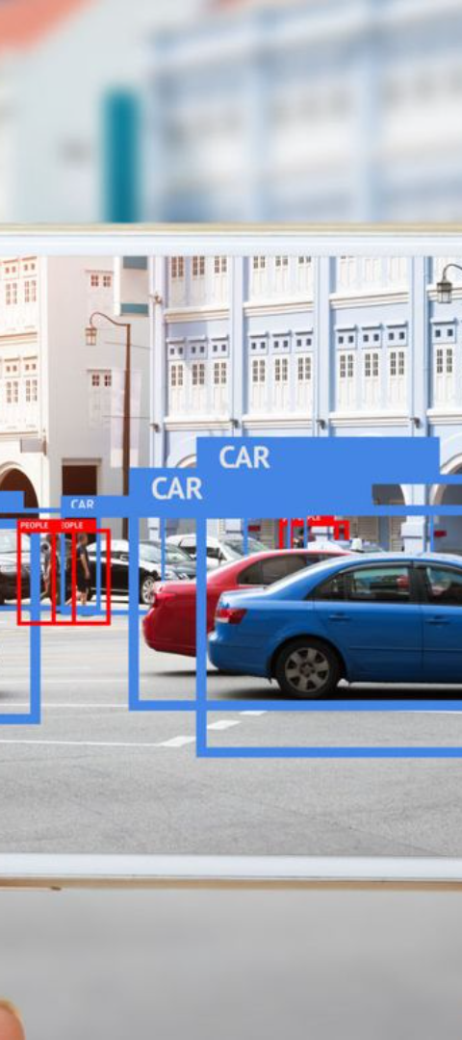
Challenges in Object Detection for Smart Cities
1
Data Privacy Concerns
2
Complex Urban Environments
Implementing object detection raises concerns about privacy and data protection, necessitating the development of ethical frameworks and standards.
Smart cities present complex and dynamic environments, posing challenges for accurate and efficient object detection and tracking.
3
Integration and Scalability
Integrating object detection solutions into existing infrastructure while ensuring scalability and seamless operation remains a significant challenge.

Slide 4
Overview of Advanced Object Detection Technologies
1. LiDAR Technology
Utilizes laser sensors for precise 3D mapping and object detection.
2. Radar-Based Systems
Employs radio waves for detecting objects, especially in adverse weather conditions.
3. Neural Network Algorithms
Advanced AI algorithms for real-time object recognition and classification.

Slide 5
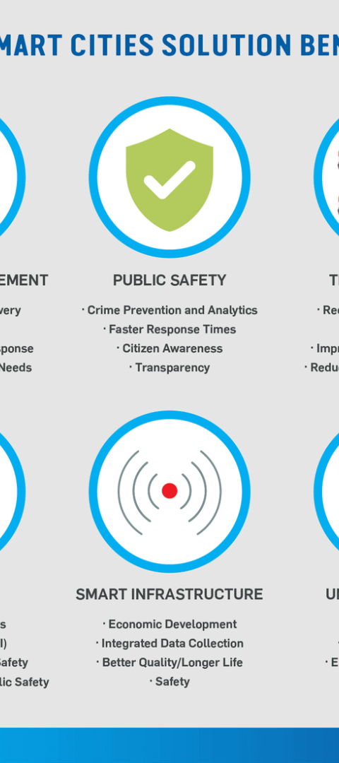



Benefits of Using VisionNet for Smart City Infrastructure
Efficiency Optimization
Enhanced accuracy and speed in object detection lead to streamlined operations.
Improved Decision-Making
Real-time data insights enable better urban planning and resource allocation.
Enhanced Safety Measures
Proactive identification of risks and potential hazards ensures public safety.

Slide 6
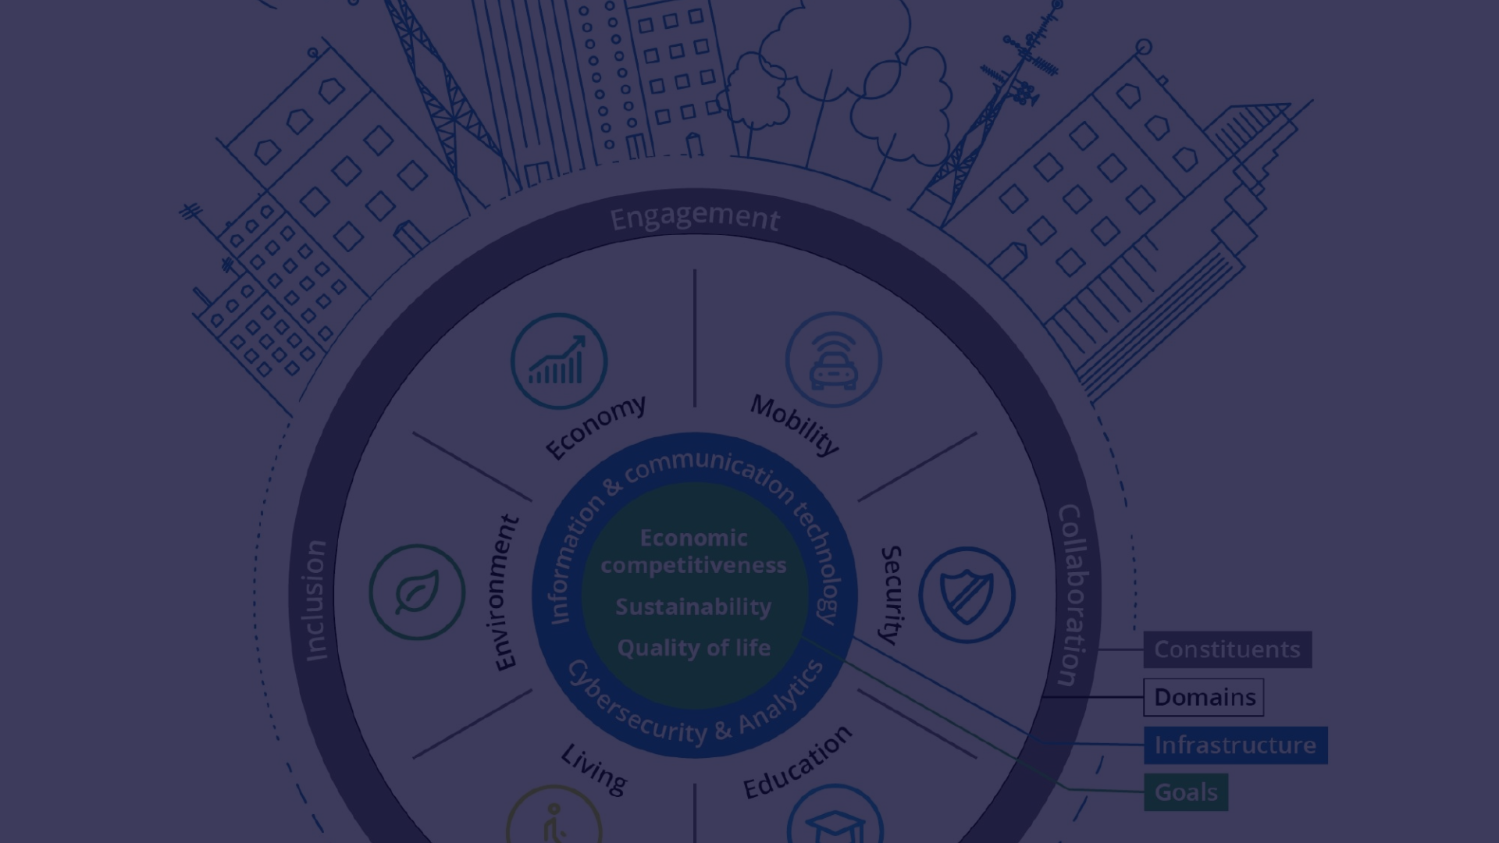
Case Studies of Successful Implementation
1
Kuala Lumpur, Malaysia
Implemented VisionNet for traffic management, resulting in a 20% reduction in congestion and improved road safety.
2
Osaka, Japan
Integrated VisionNet for public security, leading to a 30% decrease in crime rates and faster emergency response times.
3
Barcelona, Spain
Utilized VisionNet for waste management, optimizing collection routes and reducing vehicle emissions by 15%.

Slide 7
Future Developments and Potential Applications
2X
3X
Augmented Reality Integration
Environmental Monitoring
Utilizing VisionNet for AR applications such as enhanced navigation and immersive urban experiences.
Expanding VisionNet's capabilities for real-time environmental impact assessment and sustainable urban development.

Slide 8
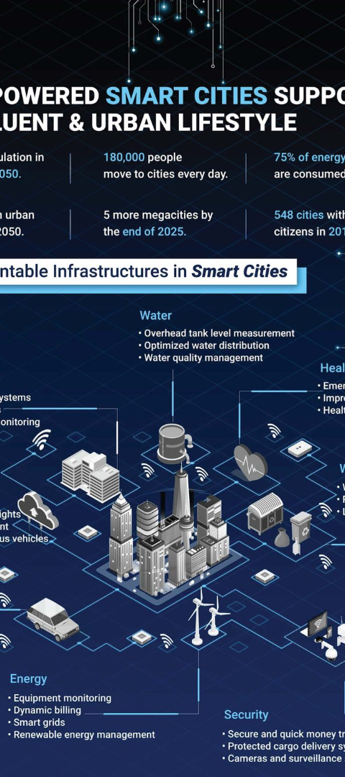
Conclusion and Call to Action
Embracing Innovation
Collaborative Approach
It's time to embrace VisionNet's advanced object detection technologies for creating smarter and safer cities.
Join the VisionNet community in driving innovation and transforming urban landscapes for the better.
Sustainable Progress
Let's work together to build sustainable and resilient cities with VisionNet's smart infrastructure solutions.

